Slide 1
String Matching
Naïve String Matching ,
Rabin Karp Algorithm
Design and Analysis of Algorithm

Slide 2
References
Intro. to Algorithms by Cormen et al
Algorithms on Strings, Trees, and Sequences. Comp. Science & Computational Biology by Dan Gusfield. Section 1.1 & 1.2
Exact String Matching Algorithms.
http://www-igm.univ-mlv.fr/~lecroq/string/index.html

Slide 3
String Matching: Introduction
Finding all occurrences of a pattern in some text
This problem arises frequently in text editing programs.
Efficient algorithms improve responsiveness
In molecular biology, biological molecules can often be approximated as sequences of nucleotides or amino acids.
Search for particular patterns in DNA sequences

Slide 4
String Matching: Introduction
Two Types:
Exact String Matching
Approximate String Matching

Slide 5
Exact String Matching Problem
Assume text is any array T[1..n] of length n
pattern is an array P[1..m] of length m≤n
Elements of T & P are characters drawn from a finite alphabet
∑. e.g., ∑ = {0,1}
or ∑= {a,b,…,z}.
P & T are strings of characters.

Slide 6
http://whocouldthat.be/visualizing-string-matching/

Slide 7
Exact String Matching Problem
T
s=2
P
b | a | c |  | a |  | b |  | c |  | a | b | c | a | ...
 |  | c |  | a |  | b |  | c

Slide 8
Exact String Matching Problem
P occurs with shift s in T or P occurs beginning at position s+1 in text T if
0 ≤ s ≤ n-m and T[s+1..s+m] = P[1..m]
i.e., T[s+j] = P[j], for 1 ≤ j ≤ m
If P occurs with shift s, s is a valid shift; otherwise we call s an invalid shift.
String matching problem: finding all valid shifts with which a given pattern P occurs in a given text T

Slide 9
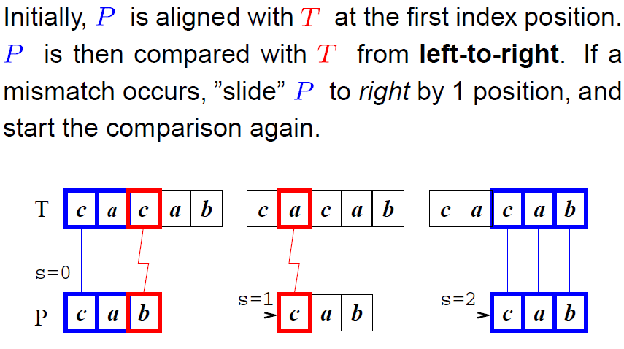
Exact String Matching Problem

Slide 10
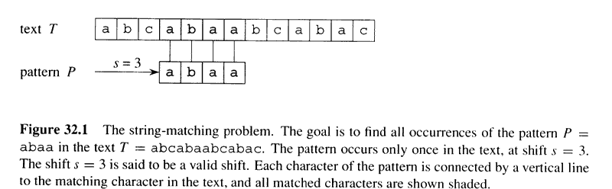
Exact String Matching Problem

Slide 11
Approximate String Matching
Given a text to search (T) and a pattern to look for (P).
Find all of the occurrences of P that exist in T, allowing a defined number of errors to be present in the matches
mispeld
misspelled

Slide 12
Approximate String Matching
The closeness of a match is measured in terms of the number of primitive operations necessary to convert the string into an exact match.
insertion: cot → coat
deletion: coat → cot
substitution: coat → cost

Slide 13
Importance
Not a problem for small input
Word Processors, utilities, in library catalog searching programs
Large Input
internet crawlers, digital libraries, e-journals.
Several hundred specialized databases holding raw DNA, RNA and amino acid strings (e.g., US GenBank)
When applied on DNA databases, search may take hours or days.

Slide 14
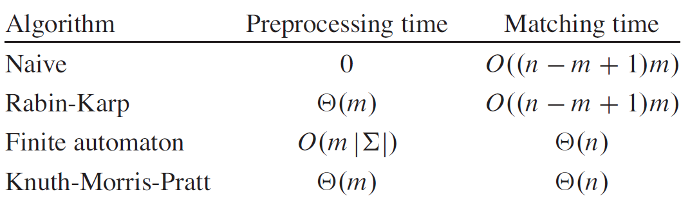
Running Time of String Matching Algorithms

Slide 15
Notation & terminology
∑* = set of all finite-length strings from alphabet ∑
ε = empty string (zero length string)
|x| = length of string x
xy = concatenation of strings x and y, length is |x|+|y|
w is a prefix of x, w╘ x, if x=wy, where y Є ∑*
w is a suffix of x, w ╛x, if x=yw, where y Є ∑*

Slide 16
Notation & terminology (cont’d)
ε is both a suffix and a prefix of every string
ab ╘ abcca
cca ╛abcca
We denote k-character prefix P[1..k] of the pattern P[1..m] by P_{k}.
So P_{o} = ε and P_{m} = P = P[1..m]
Similarly, k-character prefix of text T as T_{k}
String matching prob.: find all shifts in the range
0 ≤ s ≤ n-m such that P ╛T_{s+m}

Slide 17
Overlapping Suffices
x, y and z are strings and x ╛ z and y ╛ z if:
|x|<=|y| then x ╛ y
|x|>=|y| then y ╛ x
|x|=|y| then x = y

Slide 18
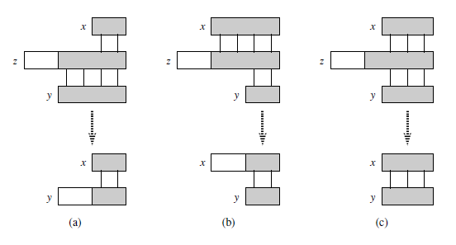
Overlapping Suffices
x
EF
ABCDEF
CDEF
z
y

Slide 19
String Comparison
The test “x=y” is assumed to take time Θ(t+1) where t is the length of the longest string z such that z╘ x and z╘ y.
t=0, when z = ε
w is a prefix of x, w╘ x,
w is a suffix of x, w ╛x,

Slide 20
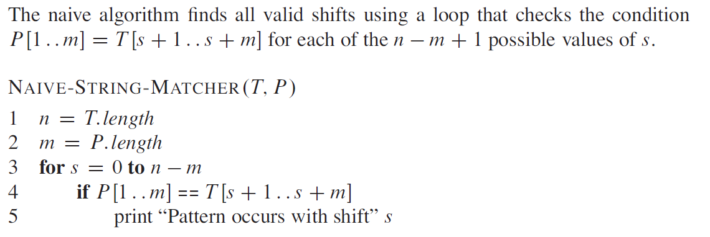
Naïve String matching Algorithm
O( (n-m+1) m)
The test in line 4 determines whether the current shift is valid; this test implicitly loops to check corresponding character positions until all positions match successfully or a mismatch is found.

Slide 21
Naïve String matching Algorithm
Finds all valid shifts using a loop that tests P[1..m] = T[s+1..s+m] for each of n-m+1 values of s
Takes Θ((n-m+1)m) time.
If m=n/2, it becomes Θ(n²)

Slide 22
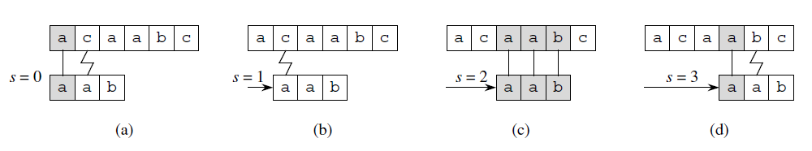
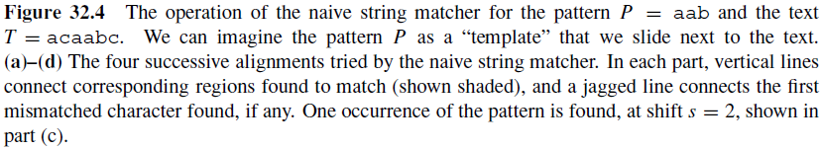
Naïve string matching Algo (Cont…)

Slide 23
Why is naïve algo. inefficient?
It tests for each of the n-m+1 possible values of s
The info. gained about text for one value of s is ignored in considering other values of s
e.g., if P=aaab and we find that s=0 is valid, then s=1,2 or 3 are invalid, since T[4]=b

Slide 24
Rabin Karp Algorithm

Slide 25
The Rabin-Karp Algorithm
Performs well in practice
generalizes to other algorithms for related problems such as 2D pattern matching
Two steps:
Preprocessing Θ(m)
Matching Θ((n-m+1)m)
Based on certain assumptions, average case running time is better
Makes use of number theoretic notions, equivalence of two numbers modulo a third number

Slide 26
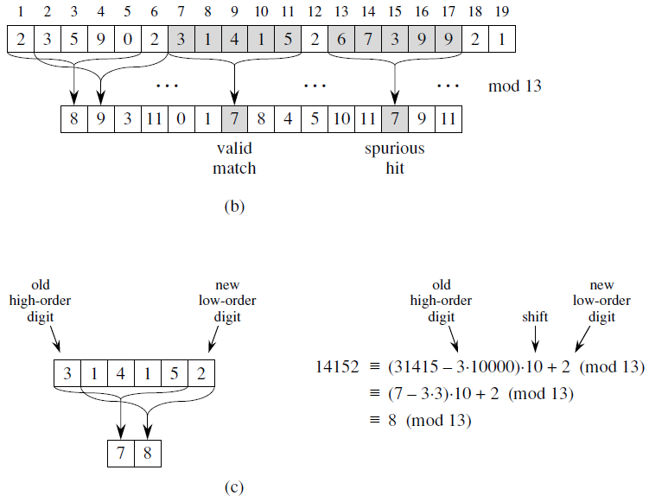
Fig 32.5

Slide 27
The Rabin-Karp Algorithm
The character string 31415 thus corresponds to the decimal number 31,415.
Given pattern P[1..m], let p denote its decimal value
Let t_{s} denote decimal value of length m
substring T[s+1..s+m] for s=0,1,…,n-m
t_{s}=p if and only if T[s+1..s+m] = P[1..m]

Slide 28
The Rabin-Karp Algorithm (Cont’d)
Assume that ∑ = {0,1,2,…,9}, each character is a decimal digit.
In general, each char. is a digit in radix-d notation, where d=|∑|
A string of k digits = a length-k decimal number
Given pattern P[1..m], let p denote its decimal value
Let t_{s} denote decimal value of length m substring T[s+1..s+m] for s=0,1,…,n-m
t_{s}=p if and only if T[s+1..s+m] = P[1..m]

Slide 29
The Rabin-Karp Algorithm (Cont’d)
Compute p in Θ(m) time
Compute all t_{s} values in Θ((n-m)+1) time
Then, we can determine all valid shifts in time Θ(m) + Θ((n-m)+1) = Θ(n)
Lets not worry that p and t_{s}’s might be very large
It takes lg(a) bits to encode number a
very large=do not fit in a computer word

Slide 30
The Rabin-Karp Algorithm (Cont’d)
We can compute p in Θ(m) time, using Horner’s rule.
p = P[m] + 10(P[m-1] + 10(P[m-2]+…+10(P[2] + 10P[1])…))
e.g., P[1..m]=“3457”, here m=4
p =7+10(5+10(4+10x3))
p =7+10(5+10(4+30)
p =7+10(5+340)
p =7+3450
p =3457

Slide 31
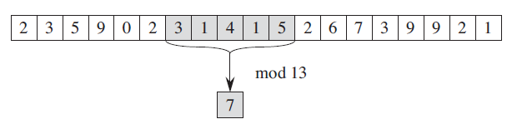
The Rabin-Karp Algorithm (Cont’d)
Similarly compute t_{o} in Θ(m) time from T[1..m]
Use t_{o} to compute each of t₁ ,t₂ ,… , t_{n-m} in constant time, which totals to Θ(n-m) time.
t_{s+1} = 10(t_{s} – 10^{m-1}T[s+1]) + T[s+m+1]
e.g., m=5 and t_{s}=31415 and T[s+5+1]=2, s=0
t_{s+1} = 10(31415 – 10000.3) + 2
= 14152

Slide 32
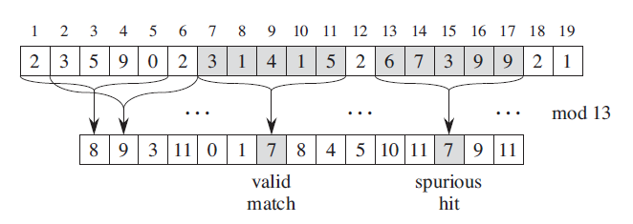

Slide 33
The Rabin-Karp Algorithm (Cont’d)
If p and t_{s} are very large to work with, mathematical operations on P do not take “constant time”
Simple cure, perform all operations modulo a suitable modulus q
q is chosen, such that dq fits in computer word, where d=|∑| and ∑={0,1,…,d-1}
We might get spurious hits, since t_{s}Ξp (mod q) does not imply that t_{s} = p

Slide 34
Fig 32.5

Slide 35
The Rabin-Karp Algorithm
Fig 32.5: The Rabin-Karp algorithm. Each character is a decimal digit, and we compute values modulo 13. (a) A text string. A window of length 5 is shown shaded. The numerical value of the shaded number is computed modulo 13, yielding the value 7. (b) The same text string with values computed modulo 13 for each possible position of a length-5 window. Assuming the pattern P = 31415, we look for windows whose value modulo 13 is 7, since 31415 ≡ 7 (mod 13). Two such windows are found, shown shaded in the figure. The first, beginning at text position 7, is indeed an occurrence of the pattern, while the second, beginning at text position 13, is a spurious hit. (c) Computing the value for a window in constant time, given the value for the previous window. The first window has value 31415. Dropping the high-order digit 3, shifting left (multiplying by 10), and then adding in the low-order digit 2 gives us the new value 14152. All computations are performed modulo 13, however, so the value for the first window is 7, and the value computed for the new window is 8.

Slide 36
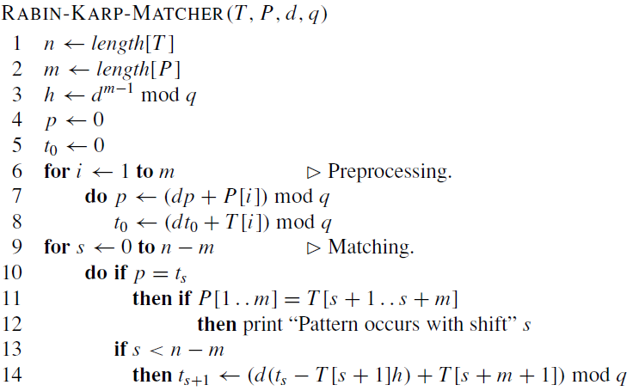
Line 3 initializes h to the value of the high-order digit position of an m-digit window.

Slide 37
The Rabin-Karp Algorithm (Cont’d)
It takes Θ(m) preprocessing time and Θ((n-m+1)m) matching time in the worst case.
In many applications, we expect few valid shifts (some constant c), then the running time is O((n-m+1) + cm) + time for spurious hits
and if q is large enough (q≥m), we can reduce spurious hits, which gives us O(n+m) running time.

Slide 38
Reference
Introduction to Algorithms
Thomas H. Cormen
Chapter # 32

